Slide 1
Presentation By
Franglin
Goal-Oriented Strategic Modelling
Using the i* Framework

Slide 2
I* - Goal Oriented Modelling Framework used in requirements engineering.
Two Main Models,
Strategic Dependency
Strategic Rational

Slide 3
Session Plan & Learning Outcomes
Explain Goal-Oriented Requirements Engineering (GORE) in simple language.
Identify actors, hard goals, soft goals, tasks and resources in a real-world scenario.
Read and create a Strategic Dependency (SD) model.
Extend an SD model into a Strategic Rationale (SR) model.
Use task decomposition, means-end and contribution links.
Explain how i* models can help identify functional and non-functional requirements.
Tutorial : Work in groups to model a travel-booking scenario and justify design decisions.
UFCFAF-30-3 Development of Information Systems Projects (DISP)

Slide 4
1. Start with the WHY
Goal-Oriented Requirements Engineering (GORE)

Slide 5
Warm-up: What does a system really need to achieve?
A requirement is easier to understand when we know the reason behind it.
Example: “The app must send an SMS” is a service.
But WHY? A possible reason is “the customer should know when the delivery arrives.”
GORE starts from goals and uses them to explore requirements.
MENTI POLL 1 Word cloud
When you hear “software requirement”, what word comes to mind?

Slide 6
Real-world example: GP appointment system
What the system does
Book an appointment
Send appointment confirmation
Show available doctors
Store appointment details
Why it matters
Patient gets care at the right time
Booking should be quick
Information should be reliable
Patient information should be protected
Key idea
Services tell us WHAT. Goals explain WHY.

Slide 7
Hard Goals vs Soft Goals
Hard Goal (functional)
A service or outcome the system should provide
Usually can be stated as something achieved
Example: “Appointment booked”
Example: “Patient diagnosed”
Soft Goal (quality / constraint)
A quality or preference about the outcome
Often asks HOW WELL?
Example: “Appointment booking is quick”
Example: “Information is reliable”
MENTI POLL 2 Multiple choice
“The online checkout should be fast.” Is this mainly a…?
Options: Hard goal | Soft goal | Actor | Resource

Slide 8
A simple language rule for beginners
Ask: “Can I point to a service/outcome?” → think HARD GOAL.
Ask: “Is this about quality, speed, cost, reliability, security, usability?” → think SOFT GOAL.
Do not worry about perfect wording at first. Focus on the meaning.
Use short phrases: “Book appointment”, “Quick booking”, “Pay fee”.
Goal = something wanted. Quality = how well it is wanted.

Slide 9
i*: think about people, not only software
i* uses social modelling: different actors have different goals and responsibilities.
An actor can be a person, role, organisation, team or system.
Ask two beginner-friendly questions:
1. WHO wants something?
2. WHO depends on WHOM to get it?
Example
Patient → Doctor → diagnosis

Slide 10
2. The i* Framework
Actors, goals and dependencies

Slide 11
The i* Framework: the core vocabulary
Main concepts
Actor
Hard goal
Soft goal
Task
Resource
Dependency link
Memory aid
Actor = WHO?
Goal = WHAT?
Soft goal = HOW WELL?
Task = HOW?
Resource = WHAT is delivered?
MENTI POLL 3 Multiple choice
Which item is an ACTOR?
Options: Quick booking | Doctor | Patient diagnosed | Payment

Slide 12
Two i* models: SD and SR
Strategic Dependency (SD)
Looks at relationships BETWEEN actors
Shows who depends on whom
Shows what is depended upon
Think: “WHO needs WHAT from WHOM?”
Strategic Rationale (SR)
Looks INSIDE an actor
Shows how an actor works towards goals
Shows alternatives and internal reasoning
Think: “HOW can this actor achieve it?”
Simple analogy
SD = map of relationships. SR = inside view of one actor.

Slide 13
3. Strategic Dependency (SD) Model
From everyday relationships to a model

Slide 14
What is a dependency?
A dependency means one actor relies on another actor for something.
The actor who needs something is the DEPENDER.
The actor who provides it is the DEPENDEE.
The “something” can be a hard goal, soft goal, task or resource.
Everyday example
Student depends on lecturer for feedback.

Slide 15
Four dependency types
What can be depended upon?
HARD GOAL — a service/outcome
SOFT GOAL — a quality
TASK — an activity
RESOURCE — an entity / information / thing delivered
Fast examples
Doctor → Patient: diagnosis
Patient → Provider: quick support
Doctor → Lab: perform blood test
Lab → Claims Manager: test report
MENTI POLL 4 Multiple choice
“Doctor depends on laboratory to perform a test.” The dependency is a…
Options: Hard goal | Soft goal | Task | Resource

Slide 16
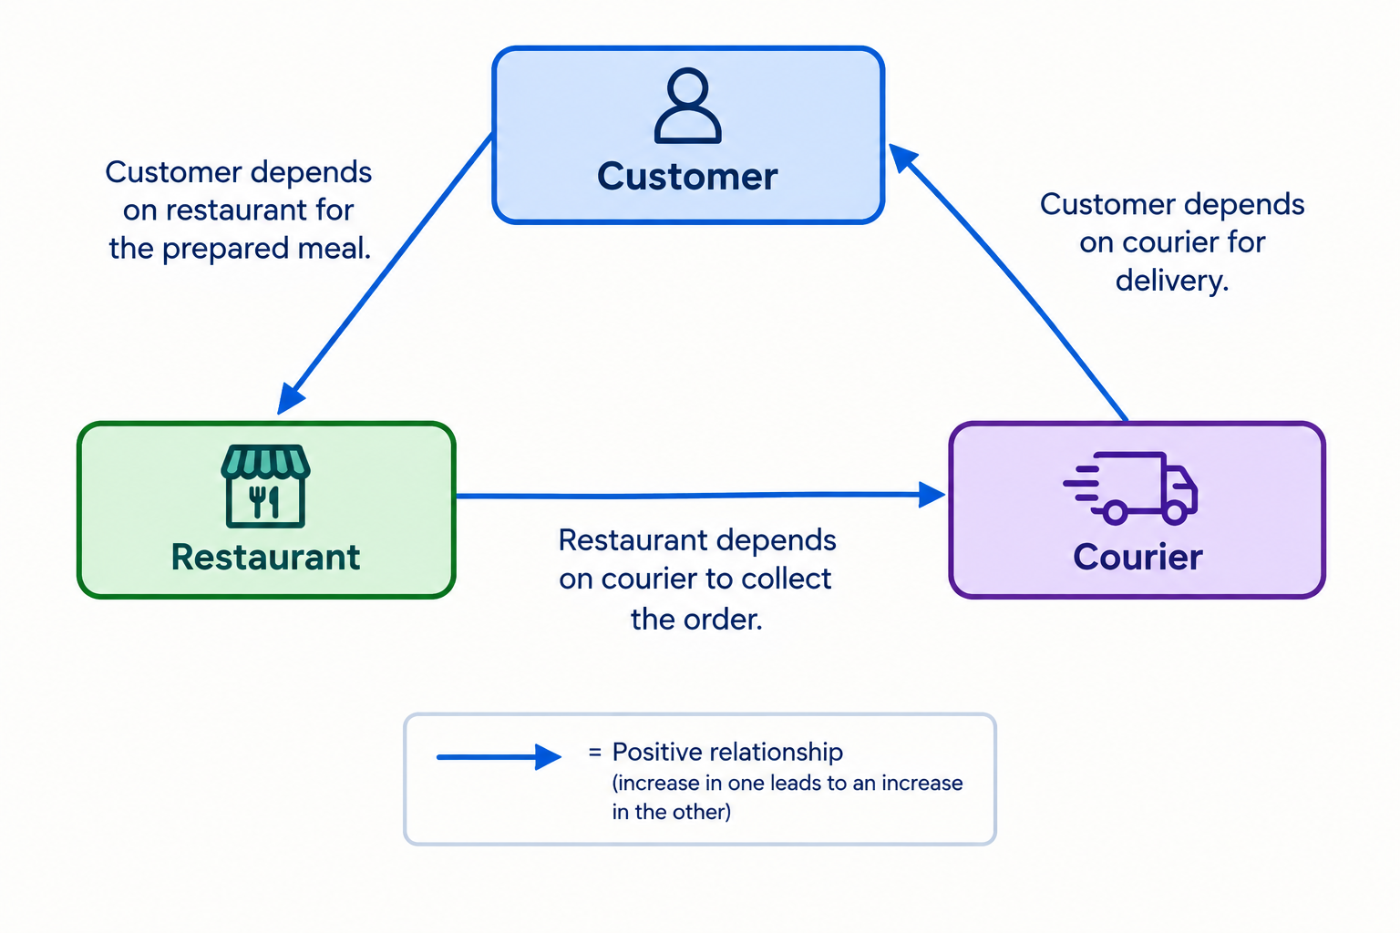
SD example: online food delivery
Customer depends on restaurant for the prepared meal.
Restaurant depends on courier to collect the order.
Customer depends on courier for delivery.

Slide 17
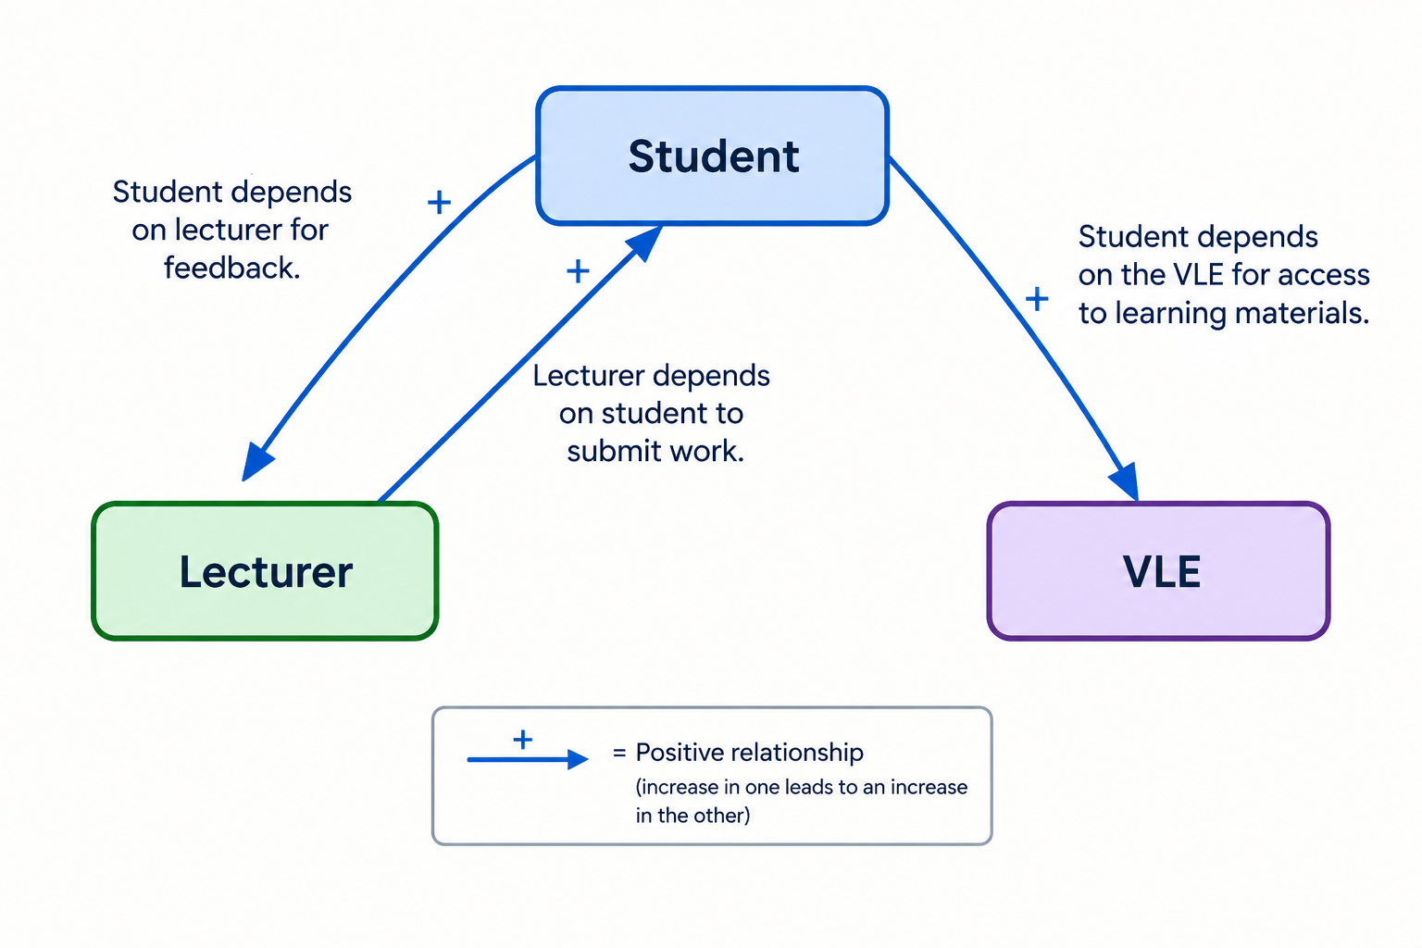
SD example: university coursework
Student depends on lecturer for feedback.
Lecturer depends on student to submit work.
Student depends on the VLE(Virtual learning) for access to learning materials.
MENTI POLL 5 Multiple choice
If a lecturer needs students to submit work, who is the DEPENDER?
Options: Lecturer | Student | VLE | Both

Slide 18
A reliable method for drawing an SD model
STEP 1 — Underline the actors in the scenario.
STEP 2 — Circle the things they want / need.
STEP 3 — Identify the relationship: WHO depends on WHOM?
STEP 4 — Classify the dependency: hard goal, soft goal, task or resource.
STEP 5 — Draw and label the dependency.
STEP 6 — Read every arrow as a sentence: “A depends on B for X.”
Beginner tip
Write the sentence before drawing the arrow.

Slide 19
Mini-practice: identify the dependency
Scenario: “A patient depends on a receptionist to register their details.”
Question 1: Who is the depender?
Question 2: Who is the dependee?
Question 3: Is “registration” a hard goal, soft goal, task or resource?
MENTI POLL 6 Multiple choice
What type is “registration of patient details” in this scenario?
Options: Hard goal | Soft goal | Task | Resource

Slide 20
Case: healthcare SD model
A healthcare example shows seven dependency relationships.
Examples include: regulator → healthcare provider for accountability (soft goal).
Healthcare provider → monitoring system for collecting/reporting patient condition (task).
Monitoring agent → patient for vital signs (resource).
Patient → healthcare provider for treatment (hard goal).
Your task
List the seven dependencies before the solution is shown.

Slide 21
SD challenge: claims and insurance
Actors in this scenario include: Patients, Physicians, Laboratories, Claims Managers and Insurance Companies.
Examples: patients depend on physicians for treatment (goal).
Physicians depend on patients to take medication (task).
Physicians and labs depend on claims managers for fee payments (resource).
Insurance companies depend on claims managers to process claims (task).
MENTI POLL 7 Multiple choice
“Insurance company depends on claims manager to process claims.” What is it?
Options: Goal | Soft goal | Task | Resource

Slide 22
4. Strategic Rationale (SR) Model
Inside an actor: how and why?

Slide 23
SD vs SR: one more time
SD asks…
Who depends on whom?
What is the dependency?
What crosses the actor boundary?
SR asks…
What does this actor want?
What tasks help achieve it?
What must a task be decomposed into?
What alternatives are available?
How does a task affect quality goals?
MENTI POLL 8 Multiple choice
You want to show how a Claims Manager completes “Approve Treatment”. Which model is most appropriate?
Options: SD | SR | Neither | Only a flowchart

Slide 24
SR: Task decomposition (AND)
A task can be broken into smaller elements that ALL need to be completed.
This is called AND decomposition.
Example: “Approve treatment” may require “Treatment assessed” AND “Sign approval document”.
Think: “I need A AND B before the main task is complete.”
Treatment
assessed
Approve
Treatment
Sign approval
document
Memory cue
AND = both / all paths are needed.

Slide 25
SR: Means-end links (OR / alternatives)
A means-end link shows different ways of achieving an end.
These are alternatives.
Example: Treatment assessed can be achieved by the Claims Manager OR by a medical assessor.
Think: “I can achieve the same end in more than one way.”
Method A
Treatment
assessed
Method B
Memory cue
OR = alternative ways.

Slide 26
SR: Contribution links
Contribution links connect tasks to soft goals.
They show whether a task helps or hurts a quality.
Use “make +” for positive contribution and “hurt -” for negative contribution.
Example: “Manual assessment” may hurt “Fast turnaround” if it takes longer.
Positive contribution (+)
Online check-in → quick service
Automated reminder → reliable attendance
Clear dashboard → easy monitoring
Negative contribution (-)
Extra manual checking → slower service
More steps → harder usability
Extra cost → affordability is reduced
MENTI POLL 9 Multiple choice
A new security check improves security but adds time. Its effect on “Fast turnaround” is likely…
Options: Positive | Negative | No contribution | It becomes an actor

Slide 27
Worked SR example: online shopping checkout
Actor: Checkout Service
Goal: Complete customer purchase
Task: Process checkout
Subtasks: Validate basket AND calculate total AND confirm payment
Alternative means for payment: card payment OR approved digital wallet
Soft goal: Fast checkout
Contribution: extra verification may improve security (+) but hurt speed (-)

Slide 28
Worked SR example: GP appointment booking
Actor: Receptionist
Hard goal: Appointment booked
Soft goal: Booking is quick
Task: Book appointment
Resource: Patient payment (if required)
Inside the task
Check patient details
Find available slot
Confirm appointment
Alternative: book manually OR use online self-service
Ask: which option helps speed?
MENTI POLL 10 Multiple choice
“Book manually OR use self-service” is an example of…
Options: AND decomposition | Means-end alternative | Contribution | Resource

Slide 29
Case: Cancer Detection SR model
Task: build an SR model from the Doctor’s perspective.
Patient depends on Doctor for diagnosis (hard goal) and determining cancer type/site (task).
To diagnose: review patient history AND perform clinical appraisal AND assess need for admission.
To determine cancer type/site: review lab and imaging results OR let a specialist review them.
Why this is useful
It naturally demonstrates AND decomposition + OR alternatives.

Slide 30
Three SR links students should recognise
AND decomposition
All child elements are needed
“Do A AND B AND C”
Break one task into components
Means-end / OR
Different alternatives
“Use A OR B”
Show different ways to achieve an end
Contribution
Task → soft goal: helps (+) or hurts (-)
MENTI POLL 11 Ranking
Which link is hardest to remember?
Options: AND decomposition | Means-end | Contribution | None

Slide 31
5. From i* Models to Requirements
Why do we model goals?

Slide 32
How i* helps a requirements engineer
Resources suggest data that may need to be stored in databases.
Tasks and hard goals help identify functional requirements.
Soft goals help identify non-functional requirements.
Dependencies reveal where one actor relies on another.
SR alternatives help discuss design choices and trade-offs.
MENTI POLL 12 Multiple choice
Which i* element most directly suggests non-functional requirements?
Options: Resource | Soft goal | Actor | Task

Slide 33
Turn a simple sentence into requirements
Business statement: “Patients need appointments to be booked quickly.”
Hard goal: Appointment booked.
Soft goal: Quick appointment booking.
Possible functional requirement: system shall allow an appointment to be booked.
Possible non-functional requirement: booking should complete within an agreed response time.
Important: the i* model helps us discover and discuss these; it does not replace detailed requirements specification.

Slide 34
6. Systems of Systems
Use the case as context, not a memorisation exercise

Slide 35
Systems of Systems (SoS): the simple idea
An SoS is a set of independent, useful systems integrated into a larger system that delivers unique capabilities.
Goal modelling can be used at different levels: global / SoS-level goals and local / constituent-system goals.
Think “many useful systems working together toward a bigger outcome.”

Slide 36
7. Hands-on Tutorial
Travel Booking Scenario Group SD modelling + presentation

Slide 37
Tutorial scenario: Travel Agency
A Travel Agency receives a reservation request for airline transport and a hotel.
The Agency researches availability, selects alternatives, and offers them to the Client.
The Client has 24 hours to select an option or cancel.
If cancelled / expired, the Agency updates the Client record and notifies the Client.
After selection, the Client provides Credit Card information within 24 hours.
The booking then covers flight + hotel, with reversals if errors occur.

Slide 38
Tutorial: extract the actors first
Work in groups of 3–4.
Step 1: List the actors only — do not draw arrows yet.
Possible actors to look for: Client, Travel Agency, Airline, Hotel, Payment/Credit Card service.
Be careful: a thing such as “reservation” is not automatically an actor.
Then compare your actor list with another group.
MENTI POLL 13 Multiple choice
Which is most clearly an ACTOR in the travel scenario?
Options: Client | Reservation | Credit Card information | Availability

Slide 39
Tutorial Step 1: identify every dependency
Use the sentence pattern: “Actor A depends on Actor B for X.”
Underline the depender (A).
Circle the dependee (B).
Box X and classify it as hard goal / soft goal / task / resource.
Aim to capture the relationships described by the scenario before adding extra assumptions.
20-minute group task
Draw your Strategic Dependency model on paper / whiteboard / PiStar.

Slide 40
Tutorial support: likely dependency candidates
Client → Travel Agency: reservation / proposed travel alternatives.
Travel Agency → Airline: flight booking.
Travel Agency → Hotel: hotel booking.
Travel Agency → Client: required Credit Card information.
Client → Travel Agency: cancellation / confirmation decision.
Where the scenario is ambiguous, label your assumption and be ready to explain it.

Slide 41
Tutorial: add the dependency types
Ask “what is X?”
A service / outcome → HARD GOAL
A quality → SOFT GOAL
An activity → TASK
Information / entity delivered → RESOURCE
Examples from the scenario
Book flight → hard goal
Quick booking → soft goal (if explicitly modelled)
Process booking → task
Credit Card information → resource
MENTI POLL 14 Multiple choice
“Client provides Credit Card information.” In i* this is best treated as a…
Options: Hard goal | Soft goal | Task | Resource

Slide 42

Tutorial: presentation format
Each group gets about 2 minutes.
Show your actors.
Explain 2–3 important dependencies using full sentences.
Explain one modelling choice that another group might make differently.
The class gives one “clear” point and one “question” for each model.
Tutor feedback
Focus on correct reasoning, not artistic drawing.

Slide 43
Extension: if we turned the SD into SR…
Choose ONE actor — for example, Travel Agency.
Pick ONE important goal — for example, complete booking.
Ask: what tasks are needed?
Ask: which tasks can be decomposed with AND?
Ask: are there alternative ways with OR / means-end?
Ask: which tasks help or hurt a soft goal such as fast booking?
MENTI POLL 15 Open text
For the Travel Agency, what is one important soft goal?

Slide 44
Exit Menti: 5-question confidence check
1. I can identify actors.
2. I can tell hard goals from soft goals.
3. I can identify task vs resource dependencies.
4. I know when to use SD rather than SR.
5. I can explain AND, OR/means-end and contribution links.
MENTI POLL 16 Likert scale
How confident are you now with i* modelling?
Options: 1 Not confident | 2 | 3 | 4 | 5 Very confident

Slide 45
Final recap: the one-minute i* checklist
ACTOR = WHO?
GOAL = WHAT does the actor want?
SOFT GOAL = HOW WELL?
TASK = HOW / what activity?
RESOURCE = WHAT is delivered?
SD = relationships between actors.
SR = reasoning inside an actor.
AND = all required parts.
OR / means-end = alternatives.
CONTRIBUTION = effect on a soft goal (+ / -).
Before you leave
Say aloud: “A depends on B for X.” Then classify X.

Slide 46
Independent practice / preparation
Recreate the Travel Booking SD model neatly.
Choose one actor and create a small SR model.
Label at least one AND decomposition.
Label at least one means-end alternative.
Add one soft goal and show one positive or negative contribution.
Prepare to explain one modelling decision in the next class.
i* modelling tools
OpenOME, PiStar and CreativeLeaf.

Slide 47
References & learning resources
Eric Yu et al., Social Modeling for Requirements Engineering (MIT Press, 2011).
Eric Yu, “Social Modeling and i*” (2009).
i* tool support: OpenOME, PiStar and CreativeLeaf.

